Slide 1
Reporter
Andranik Barseghyan
Internship

Slide 2
CONTENTS
Part 01
| Introduction
Part 02
| Coder vs Programmer
Part 03
| Computer science. Algorithm
Part 04
| Web development
Part 05
| Front-end
Part 06
| Back-end

Slide 3
Introduction
30%
JavaScript
45%
Python
25%
GO: With GO Language

Slide 4



Introduction
Nobody needs programmers
Artificial intelligence
Robotics

Slide 5

GO to your Goal

Slide 6

Go nowhere

Slide 7

Coder vs Programmer

Slide 8

Computer science
Computer science (sometimes called computation science or computing science, but not to be confused with computational science or software engineering) is the study of processes that interact with data and that can be represented as data in the form of programs. It enables the use of algorithms to manipulate, store, and communicate digital information. A computer scientist studies the theory of computation and the practice of designing software systems.
Its fields can be divided into theoretical and practical disciplines. Computational complexity theory is highly abstract, while computer graphics emphasizes real-world applications. Programming language theory considers approaches to the description of computational processes, while computer programming itself involves the use of programming languages and complex systems. Human–computer interaction considers the challenges in making computers useful, usable, and accessible.

Slide 9
Algorithm
Checking the correctness of the algorithm
Problem definition
Documentation preparation
Designing an algorithm
Program testing
Design
Development of a model
Analysis of algorithm
Implementation of algorithm
Specification of the algorithm

Slide 10
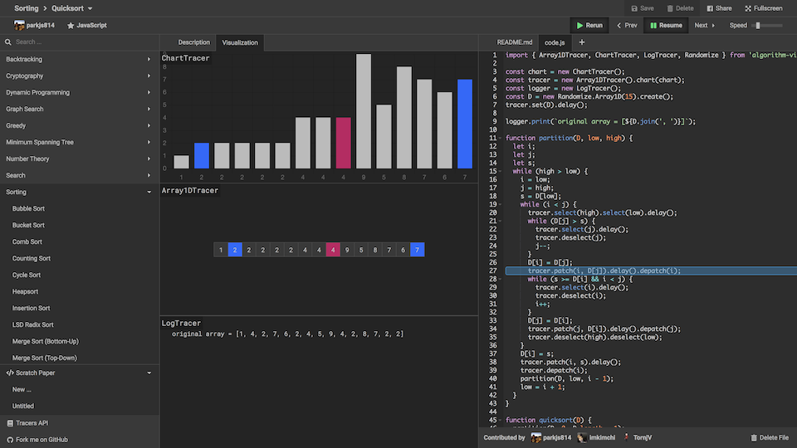
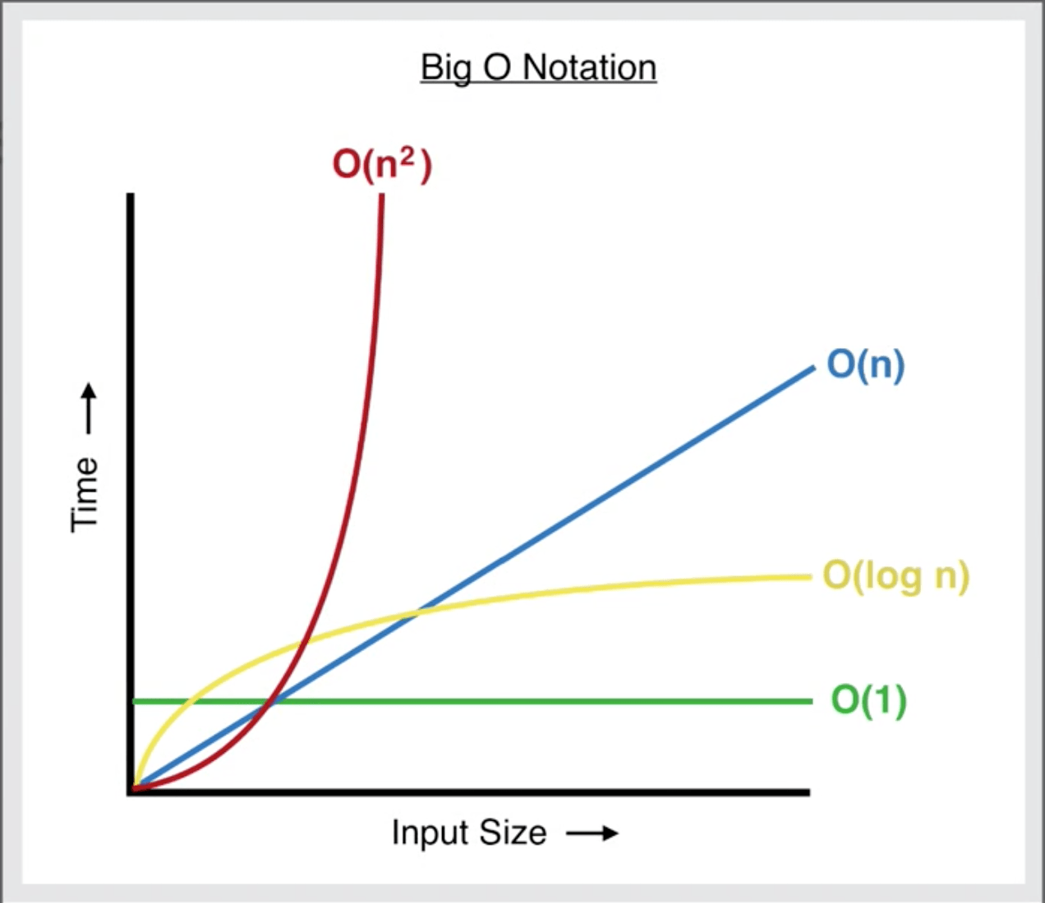
Algorithm
JSAV. The JavaScript Algorithm Visualization Library
http://jsav.io/
Add your words here,according to your need to draw the text box size

Slide 11









Web development
Web development is the work involved in developing a web site for the Internet (World Wide Web) or an intranet (a private network). Web development can range from developing a simple single static page of plain text to complex web-based internet applications (web apps), electronic businesses, and social network services. A more comprehensive list of tasks to which web development commonly refers, may include web engineering, web design, web content development, client liaison, client-side/server-side scripting, web server and network security configuration, and e-commerce development.

Slide 12
Web development
Front-end Developer
A front-end developer is a web developer that codes the front end of a website. While web design is the way a website looks, front end development is how that design actually gets implemented on the web.The pages of the internet are a sum of layers—structure, data, design, content, and functionality.
Full Stack Developer
A full stack web developer is a person who can develop both client and server software.
Back-end Developer
A back-end developer is a type of programmer who creates the logical back-end and core computational logic of a website, software or information system. The developer creates components and features that are indirectly accessed by a user through a front-end application or system.

Slide 13
Web development
Discipline
Time
Diligence

Slide 14

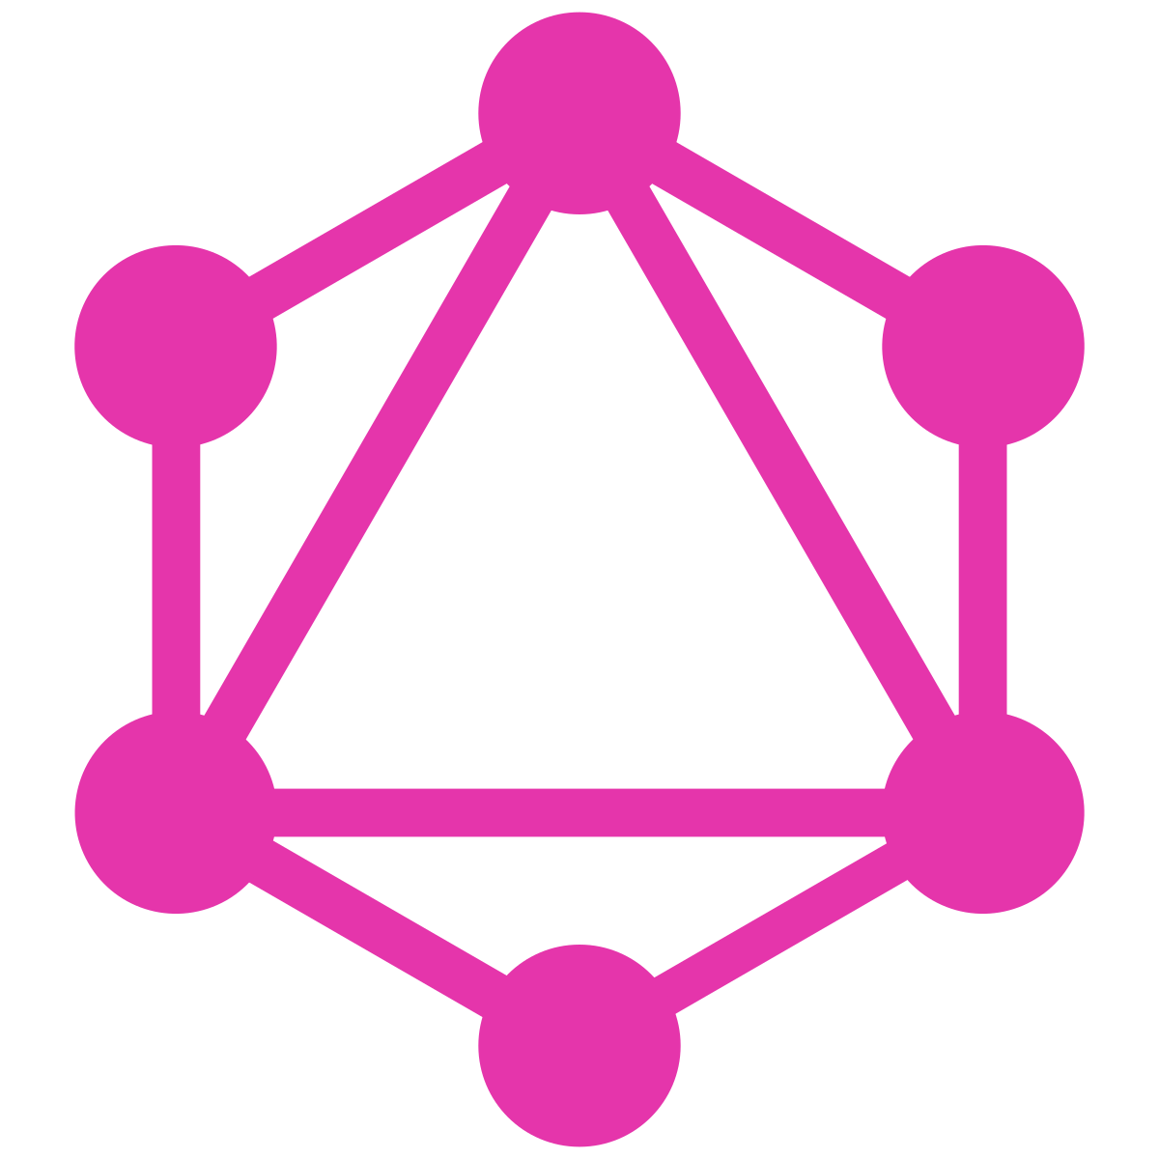





Front-end
learn

Slide 15



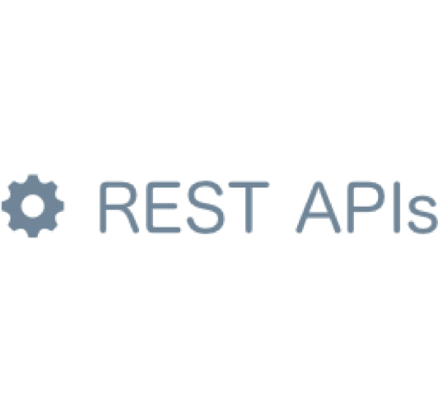





Back-end

Slide 16

Thank You

